Slide 1
PROJECT REPORT - 2

Slide 2
HG ( 29 Jan 2018)
S. no. | Started on | Auto at stand | Coming | Going | Passing
1 | 9:06 am | 13 | (0) (0) | (5) | (1) (2) (5) (2)
2 | 9:11 am | 14 | (0) (0) | (5) (5) (5) (5) | (0)
3 | 9:16 am | 12 | --------- | (5) | (3) (2) (1) (1)
4 | 9:21 am | 11 | (0) | (5) (3Re) | (1) (4) (5)
5 | 9:26 am | 10 | (0) | (5) (5) | (5) (1) (3)
6 | 9:31 am | 9 | (0) | (5) (0) | (4) (5) (1)
7 | 9:36 am | 8 | (0) (0) | (7) (5) | (2) (5) (5) (0)
8 | 9:41 am | 8 | ----- | --------- | (2) (5)
9 | 9:46 am | 8 | (0) (0) (0) (0) (0) (0) | (6) (5) | (1) (1)

Slide 3
SOME ADDITIONAL STATEMENT
9:06 am 1 Auto waiting with 2 passenger +3 go at 9:08 am. (2 min)
9:08 am 1 Auto waiting with 1 passenger +1+3 go at 9:12 am. (4 min)
9:15 am 1 Auto waiting with 1 passenger +4 go at 9:17 am. (2 min)
9:20 am 1 Auto waiting with 1 passenger +3 go at 9:22 am. (2 min)
9:22 am 1 Auto waiting with 2 passenger +1+1+1 go at 9:26 am. (4 min)
9:26 am 1 Auto waiting with 1 passenger +1+1+1+1 go at 9:28 am. (2 min)
9:28 am 1 Auto waiting with 1 passenger +1+3 go at 9:31 am. (3 min)
9:31 am 1 Auto waiting with 1 passenger +1+3 go at 9:33 am. (2 min)
9:33 am 1 Auto waiting with 1 passenger +1+3 go at 9:36 am. (3 min)
9:36 am 1 Auto waiting with 3 passenger +1+1 go at 9:40 am. (4 min)
9:41 am 1 Auto waiting with 2 passenger +4 go at 9:47 am. (6 min)
9:47 am 1 Auto waiting with 1 passenger +2+2 go at 9:49 am. (2 min)

Slide 4
Vishwanath Temple (31 Jan 2018)
S. no. | Started on | Auto at stand | Coming | Going | Passing
1 | 2:35 pm | 5e , 1 | (0) (0) (0) | (4) | (5) (5)(4) (5e) (3,1d)
2 | 2:40 pm | 5e, 3 | (3) (0) (0) (0) | (4) (5) (4) | (1)
3 | 2:45 pm | 5e, 5 | (5) | (3) (5e) (5) (7e) (5e) (5) (9e) (0) (3) | (5) (5,d3) (5e)
4 | 2:50 pm | 1e, 1 | (5)(4) (0) (5) | (5) (5e) | (0,3p) (5)
5 | 2:55 pm | 1e, 4 | (2) (0) (3e) | (5) (4) (1re) | (3,1d) (4,1d)
6 | 3:00 pm | 2e, 4 | (0) | (5) (5e) (5) | (4) (2)
7 | 3:05 pm | 1e, 3 | (5) (0) (2) | (5) (5) | (2,3p)
8 | 3:10 pm | 1e, 4 | ----------- | (2) (6) (2) | (2,2p) (0,3p) (5) (2) (4) (0) (5,2d)
9 | 3:15 pm | 1e, 1 | (3) (0) (4) (3) (1e) | (6) (3) | (3) (2,2d) (3)
10 | 3:20 pm | 2e, 3 | (10e) | (0) (3) (5) (1re) (6) | (5,2d) (5) (3) (2) (0e) (6)

Slide 5
HG ( 31 Jan 2018)
S. no. | Started on | Auto at stand | Coming | Going | Passing
1 | 3:40 pm | 13 | ------- | --------- | (5) (0) (4)
2 | 3:45 pm | 13 | -------- | -------- | (5) (5) (3) (0) (0) (1) (0) (0) (0) (0)
3 | 3:50 pm | 13 | -------- | (5) | (4) (2,1d)
4 | 3:55 pm | 12 | (0) | (5) (0) | (4,1d)(0) (1) (1,1d)(5,3d)
5 | 4:00 pm | 11 | (0) | (6) | (6) (3) (0)
6 | 4:05 pm | 11 | (2) | (5) | (0) (5,3d) (4,2d)
7 | 4:10 pm | 11 | ------- | (5) | (0) (1) (4,2d) (5) (0)
8 | 4:15 pm | 10 | -------- | (0) (5) | (2,2d) (5,3d) (5)
9 | 4:20 pm | 8 | (4) | (5) | (4,2d) (2,2d,2p) (4)
10 | 4:25 pm | 8 | (5)(0) | -------- | (4,2d)(4) (0) (4,1d) (0)
11 | 4:30 pm | 10 | (0) | (5) (5) | (4) (4,3d) (3)
12 | 4:35 pm | 9 | (1) | (0) | (3,1d) (2)

Slide 6
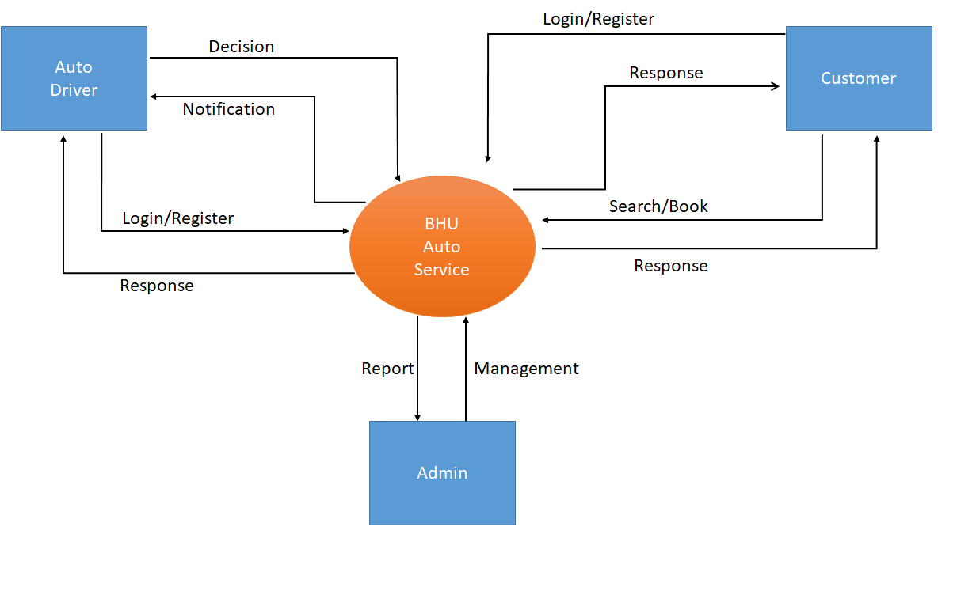
0 Level Flow Diagram

Slide 7
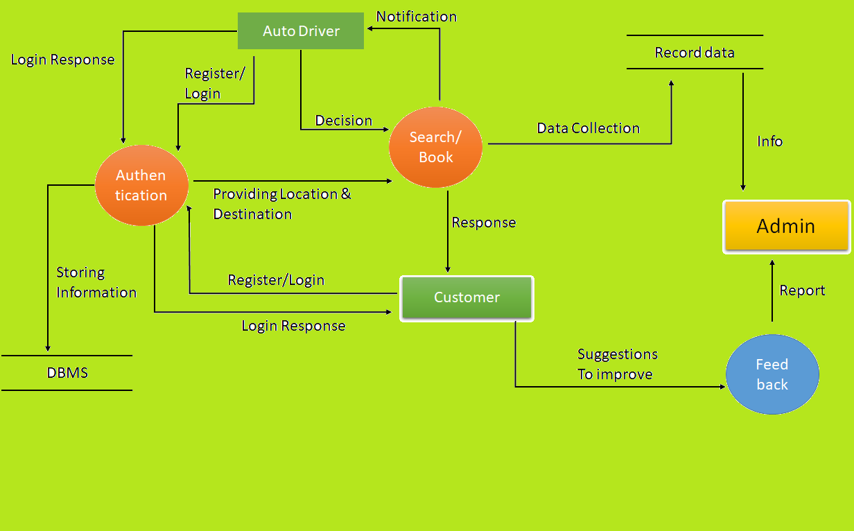
1 Level Flow Diagram

Slide 8
THANK YOU

